Slide 1

PECK-SIMPSON TEAM
THE MARKETING
ADVANTAGE
Real Estate. Real Relationships. Real Results.

Slide 2

STRATEGY
Price with confidence
We assess location, condition and comparable sales to build a market-informed pricing strategy.
PECK-SIMPSON | KW SOUTH TAMPA

Slide 3
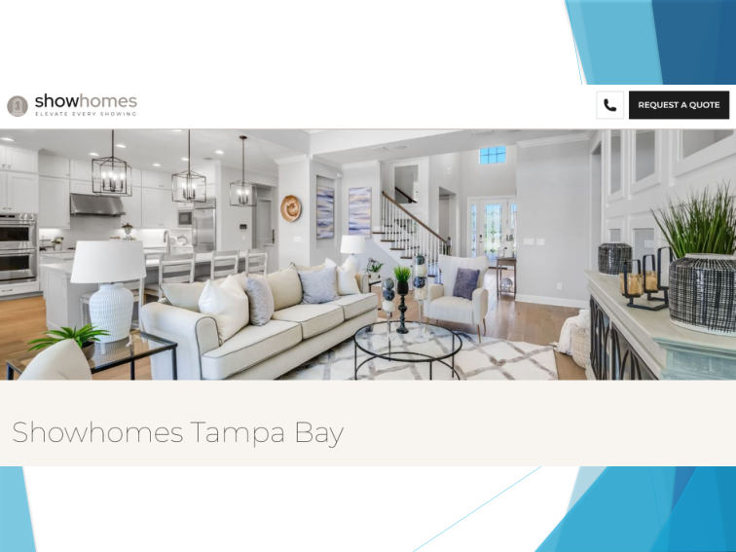
PRESENTATION
Make a powerful first impression
Property preparation and staging guidance help your home look its best to prospective buyers.
PECK-SIMPSON | KW SOUTH TAMPA

Slide 4

PRODUCTION
Professional photography and video
High-quality interior and exterior photography, cinematic walkthroughs, 3D tours and floor plans.
PECK-SIMPSON | KW SOUTH TAMPA

Slide 5
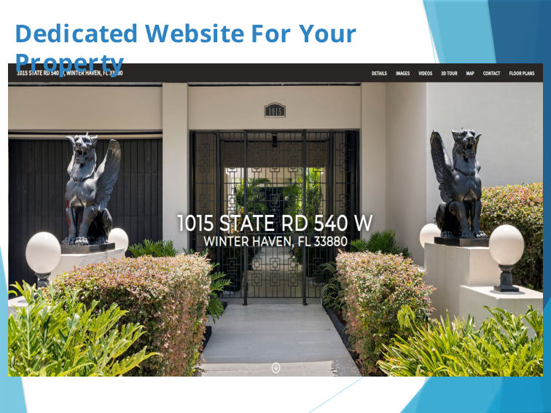
DIGITAL EXPERIENCE
A website dedicated to your property
Give buyers a central place to explore photos, video, maps, tour options and property details.
PECK-SIMPSON | KW SOUTH TAMPA

Slide 6
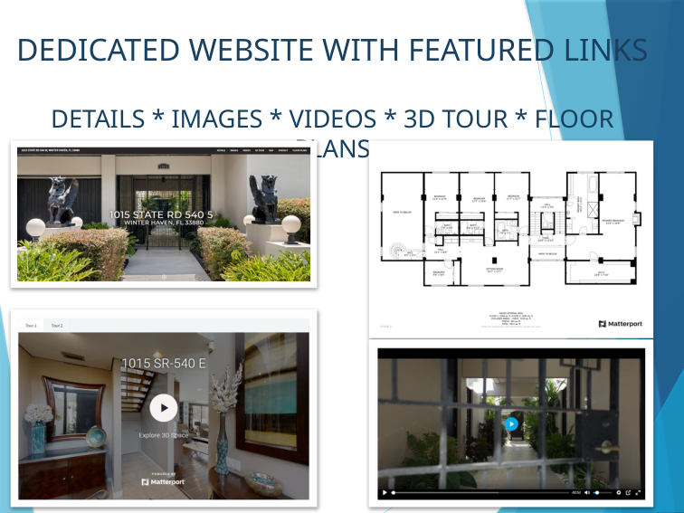
IMMERSIVE MARKETING
More than a photo gallery
Combine images, walkthroughs, 3D tours and floor plans to help buyers picture life in the home.
PECK-SIMPSON | KW SOUTH TAMPA

Slide 7

ONLINE REACH
Digital marketing built to attract attention
Campaign examples from the presentation showcase the tools we use to promote listings.
PECK-SIMPSON | KW SOUTH TAMPA

Slide 8

SOCIAL CAMPAIGNS
Showcase homes on social media
Reach home shoppers with visually strong listing content and targeted digital exposure.
PECK-SIMPSON | KW SOUTH TAMPA

Slide 9

PRINT MARKETING
Beautiful marketing in buyers’ hands
Featured listing brochures complement the digital campaign with polished property details.
PECK-SIMPSON | KW SOUTH TAMPA

Slide 10

OPEN HOUSES
Create more opportunities to see the home
Use open-house marketing, property information and follow-up to support buyer engagement.
PECK-SIMPSON | KW SOUTH TAMPA

Slide 11

AGENT NETWORK
Put your listing in front of agents
Broker outreach can bring your home to the attention of professionals with active buyers.
PECK-SIMPSON | KW SOUTH TAMPA

Slide 12
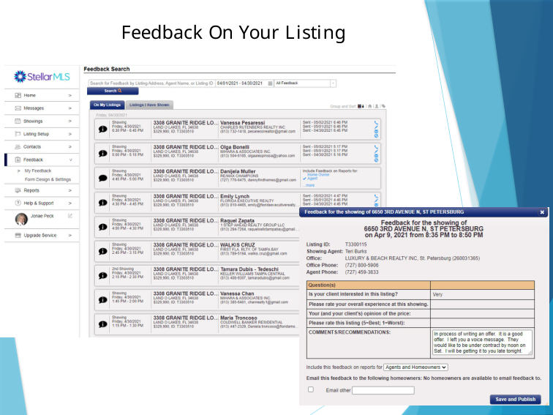
COMMUNICATION
Stay informed throughout the process
Track showing activity, gather feedback and refine the marketing plan as the market responds.
PECK-SIMPSON | KW SOUTH TAMPA

Slide 13

PROVEN TRACK RECORD
Experience supported by results
Our RealTrends recognition and team achievements demonstrate sustained production.
PECK-SIMPSON | KW SOUTH TAMPA

Slide 14

LOCAL EXPERIENCE
A team with a record of achievement
Keller Williams South Tampa recognition reflects our commitment to clients and outcomes.
PECK-SIMPSON | KW SOUTH TAMPA

Slide 15
YOUR HOME. OUR PRIORITY.
Your next move deserves a strategy
Jonaé Peck | 813-404-1536 | JonaePeck@gmail.com
Carey Simpson | 727-600-7583 | Carey@CareySimpson.com
KELLER WILLIAMS SOUTH TAMPA | PECK-SIMPSON TEAM

